Slide 1
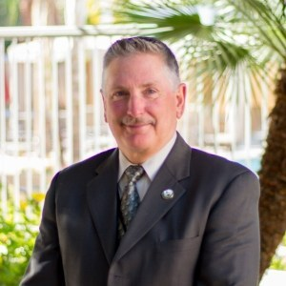
DATES & LOCATION:
April 22nd – 26th , 2024
0800-1700
Everett Police Department:
1121 SE Everett Mall Way
Everett, WA. 98208
Contact Officer Andrew Williams
Everett Police Department
(425) 257-8445
Basic FTO (Field Training Officer) Academy
40-Hour Course (5 Days)
San Jose Model (SJM) for Field Training
Designed for Police Officers, Sheriff’s Deputies, State Troopers, and Correction & Detention Personnel.
This course is prepares attendees for the assignment of Field Training Officers. This class is specific to agencies who utilize the San Jose Model (SJM) for field training. Upon class completion, attendees will be trained to evaluate student officer performance, rate the performance utilizing the Standardized Evaluation Guidelines (SEGs), and properly document the observed performance.
THIS CLASS INCLUDES:
Our curriculum is recognized by
AZPOST and by
Alaska Police Standards Council
To register, please visit the David J. Harris & Associates website (ftoschool.com), or email ftoschool@gmail.com.
Instructor Development
Adult Learning Methodologies
Coach-Pupil Method of Instruction
Lesson Planning
Evaluation Rules
Formula for Documentation
How to Deal with the Incapable Students
Extensions and Not Responding to Training Issues
The Ethical Considerations of Field Training Programs
Daily Observation Reports (DOR) based on a student’s performance, utilizing the SEGs
Watching videos of a student officer performing various tasks and evaluating performance according to SEGs
Any questions, please contact:
Sgt. David J. Harris
(425) 426-6350
ftoschool@gmail.com
Cost: $497.00 per student, which includes training materials. * No refunds if not requested within 30 days of the class.

