Slide 1
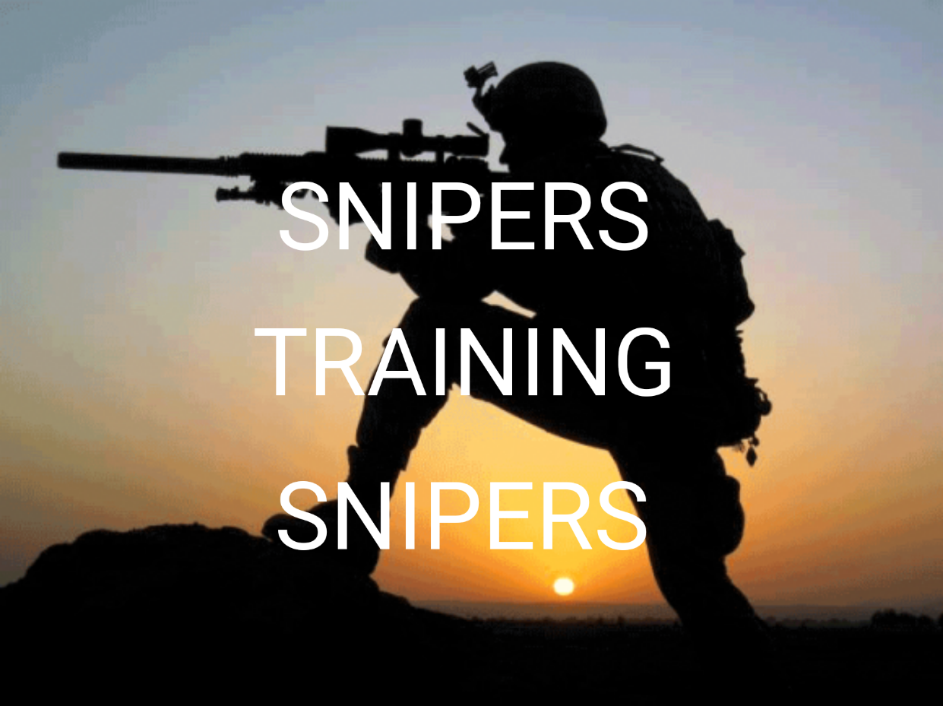
Sniper Advanced
Skills and Tactics
July 15th-19th, 2024
Richland, WA
Sponsored by:
The Richland Police Department
Snipercraft Northwest will be teaching Sniper Advanced Skills and Tactics in Richland, WA
July 15th – 19th, 2024
For registration and more information please go to www.snipercraftnw.com
or call (206) 255-5517

